Slide 1

Taking Omid to the Clouds: Fast, Scalable Transactions for Real-Time Cloud Analytics
O. Shacham • Y. Gottesman • A. Bergman • E. Bortnikov • E. Hillel • I. Keidar
Yahoo Research

Slide 2
Agenda
Introduction to Omid
Omid low latency optimizations
Apache Phoenix integration
Notes:
Introduce omid
show paper contributions:

Slide 3
Agenda
Introduction to Omid
Omid low latency optimizations
Apache Phoenix integration

Slide 4
Omid (Hope in Persian)
Transactional API over NoSQL key value
Client Library + Runtime Service
Snapshot Isolation consistency
Open source Apache incubator

Slide 5
Transactions and Snapshot Isolation
Begin
Commit
read(x)
Write(x)
Begin
Commit
Read(x)
Write(x)
Aborts only write-write conflict
Notes:
Each transaction has begin - commit
read see...
write tentative...
write-write, overlap time and writeset

Slide 6
Omid Architecture - Write
Conflict Detection
tsr
Begin
Client
API
Commit(k1,k2…)
Transaction Manager
Timestamp – tsc
Timestamp - tsr
Put(k1,v1,tsr)
commit
Data store
Data store
Data store
Commit table
K1
V1
tsr
tsc
tsr
tsc
Notes:
[2 mins]
arch - API,TM,CT
once commited all keys are valid

Slide 7
Omid Architecture – Read
tsr’
Client
API
Begin
Transaction Manager
Timestamp – tsr’
Get(k1,t<=tsr’)
Get tsc
Data store
Data store
Data store
Commit table
K1
V1
tsr
tsr
tsc
Notes:
rarely going to happen
round trip

Slide 8
Omid Bottleneck
Omid preferred throughput over latency – batch
Stopped Omid from scaling
High latency
Transaction Manager
Bottleneck
Commit table
Notes:
Begin commit have to wait for batch to end
High text

Slide 9
Taking Omid to the Cloud
Introduction to Omid
Omid low latency optimizations
Apache Phoenix integration
Notes:
[5 mins]
scale better
run in lower latency

Slide 10
Omid Low Latency
Distribute commit table writes
Remove Omid bottleneck
Fast path transactions
New API for single key transactions

Slide 11
Distribute Commit Table Updates
Conflict Detection
tsr
Begin
Client
API
Commit(k1,k2…)
Transaction Manager
Timestamp – tsc
Timestamp - tsr
Put(k1,v1,tsr)
Data store
Data store
Data store
Commit table
tsr
tsc
K1
V1
tsr
Not so trivial!
Notes:
violate snapshot isolation

Slide 12
SI Violation Example
tsr
Begin
Client 2
API
Client 1
API
Commit(k1,k2…)
Transaction Manager
Timestamp – tsc
Timestamp - tsr
Get(k2)
Put
Get(k1)
Data store
Data store
Data store
Commit table
tsr
tsc
K1
V1
tsr
K2
V2
tsr

Slide 13
SI Violation Solution - Invalidation
tsr
Client 2
API
Client 1
API
Commit(k1,k2…)
Transaction Manager
Timestamp - ts
Get(k1)
Invalidate tsr
Data store
Data store
Data store
Commit table
tsr
INVALID
K1
V1
tsr
K2
V2
tsr
Notes:
Invalidate with check and mutate

Slide 14
Fast Path Transactions
Many workloads have singe key transactions
Wasteful access to TM for timestamps
New API – Only access data table without TM
brc(key)
bwc(key,val)
br(key) + wc(key,val)
Notes:
[8 mins]
Single update
Single read-modify-write

Slide 15
Fast Path Transactions
Global Clock
Client
API
Transaction Manager
bwc(k1,v1)
Data store
Data store
Commit table
Local Clock
Local Clock
K1
V1
tsr
tsc
Notes:
timestamps taken from local clock
maintain local clock
Syncronized animation

Slide 16
SI Requires Local Validation
Global Clock
Client 2
API
Client 1
API
Begin
Transaction Manager
Timestamp - tsr
bwc(k1,v1)
Put
Conflict Detection
Local Clock
Local Clock
Data store
Data store
Commit table
K1
V1
tsr
Notes:
FP doesn’t access TM – must do conflict detect in region

Slide 17
Evaluation
HBase cluster
YCSB
Transaction sizes 1-10
Notes:
[10 mins]
Singleton transactions where taken care by FP

Slide 18
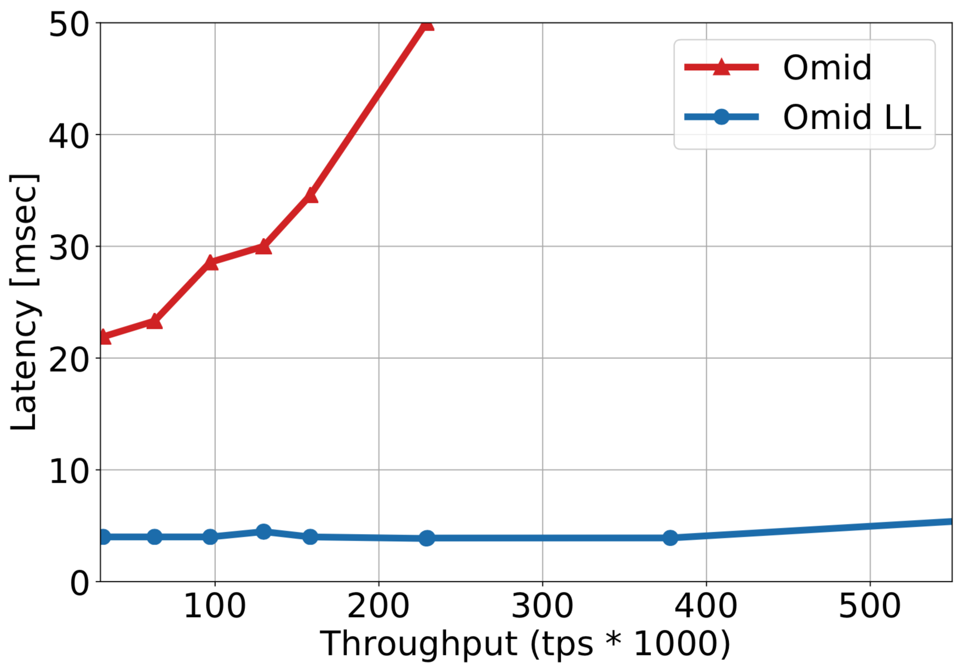
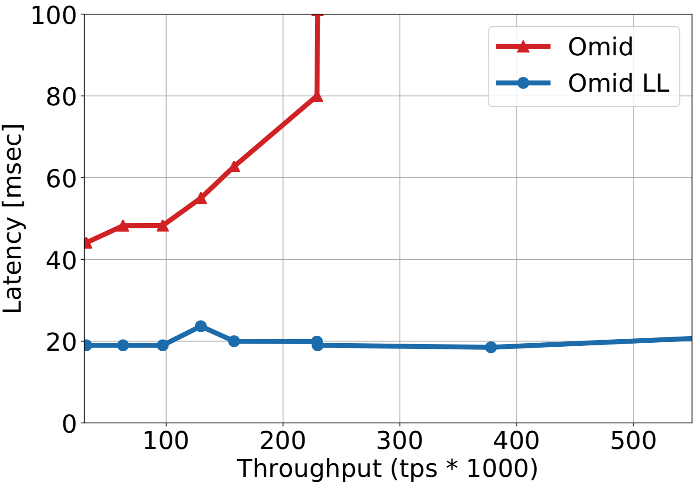
Throughput Latency
2.5X
7X
Transaction Size = 1
Transaction Size = 10
Notes:
Tx1 performance gain significant

Slide 19
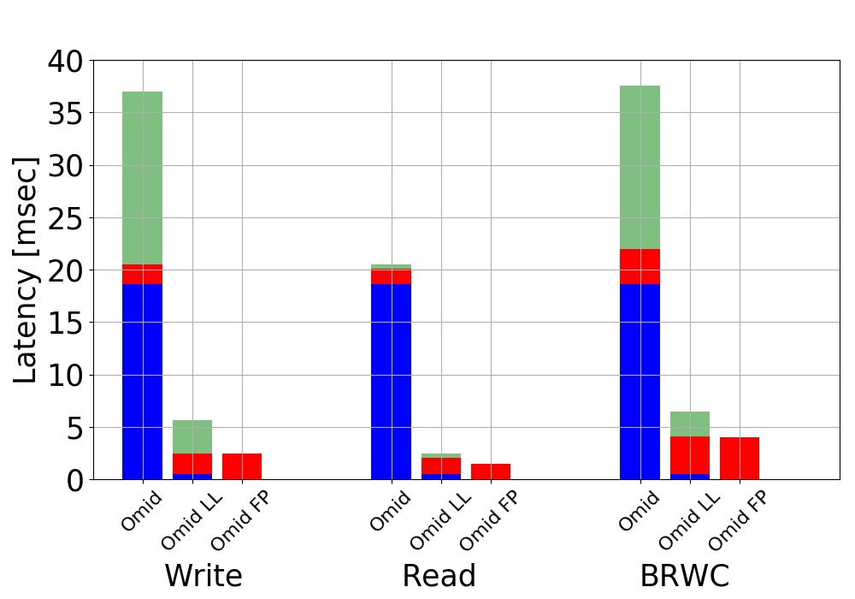
Latency Breakdown
Begin Time
Data Time
Commit Time
Single key transactions
Notes:
(remove right) + legand

Slide 20
Agenda
Introduction to Omid
Omid low latency optimizations
Apache Phoenix integration
Notes:
[12 mins]
Separate branch
default in phoenix

Slide 21

Apache Phoenix
SQL interface over HBase
Transforms SQL queries into native HBase API calls
Notes:
Use omid as the transactional layer of Phoenix

Slide 22
Omid Integration
Support Phoenix coprocessors
Integrate Omid’s code within HBase coprocessors
Add functionality
Construction of secondary indexes
Snapshot isolation exclude current - SIX
Notes:
In order to integrate omid...
computaion serverside high performance
omid functionality to coprocesssors

Slide 23
Secondary Index Creation
Phoenix on the fly index creation
Secondary index from non empty table
During creation table get updated
New fence API
Abort transaction that overlap fence
Notes:
[13 min]
To start this process
Single point in time

Slide 24
Secondary Index Creation
Phoenix on the fly index creation
Coprocessor to populate new index table with history
Coprocessor to augment writes to table to writes to index
Coprocessor A
CREATE INDEX started
Coprocessor B
CREATE INDEX complete
T1
T3
Omid fence API
T2
Install coprocessors
time
Notes:
Create index for non empty table that keeps getting writes
Atomic only for start and not whole process can take days

Slide 25
Snapshot Isolation Exclude Current - SIX
BEGIN;
INSERT INTO T
SELECT ID+10 FROM T;
COMMIT;
read
write
Notes:
read and duplicate

Slide 26
Checkpoints
BEGIN;
INSERT INTO T
SELECT ID+10 FROM T;
COMMIT;
read
checkpoint
write

Slide 27
Summary
Omid is a mature transactional layer over HBase
Omid low latency improves throughput latency and scalability
Integrated into Phoenix with new features

